Slide 1
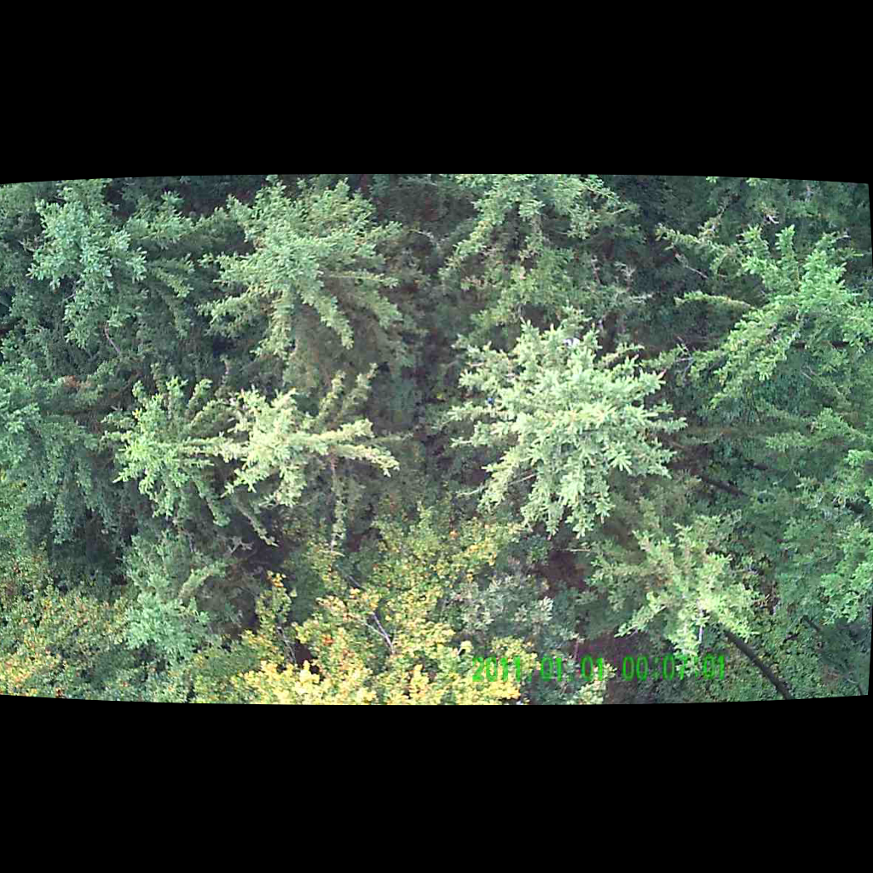
UNSUPERVISED PERSON LOCALIZATION IN WISAR Intermediate Results
Team C9
Nikolas Boldis Daniel Deutsch Lisa Schneckenreiter Uta Wagner
UE Computer Vision
12th January, 2022

Slide 2
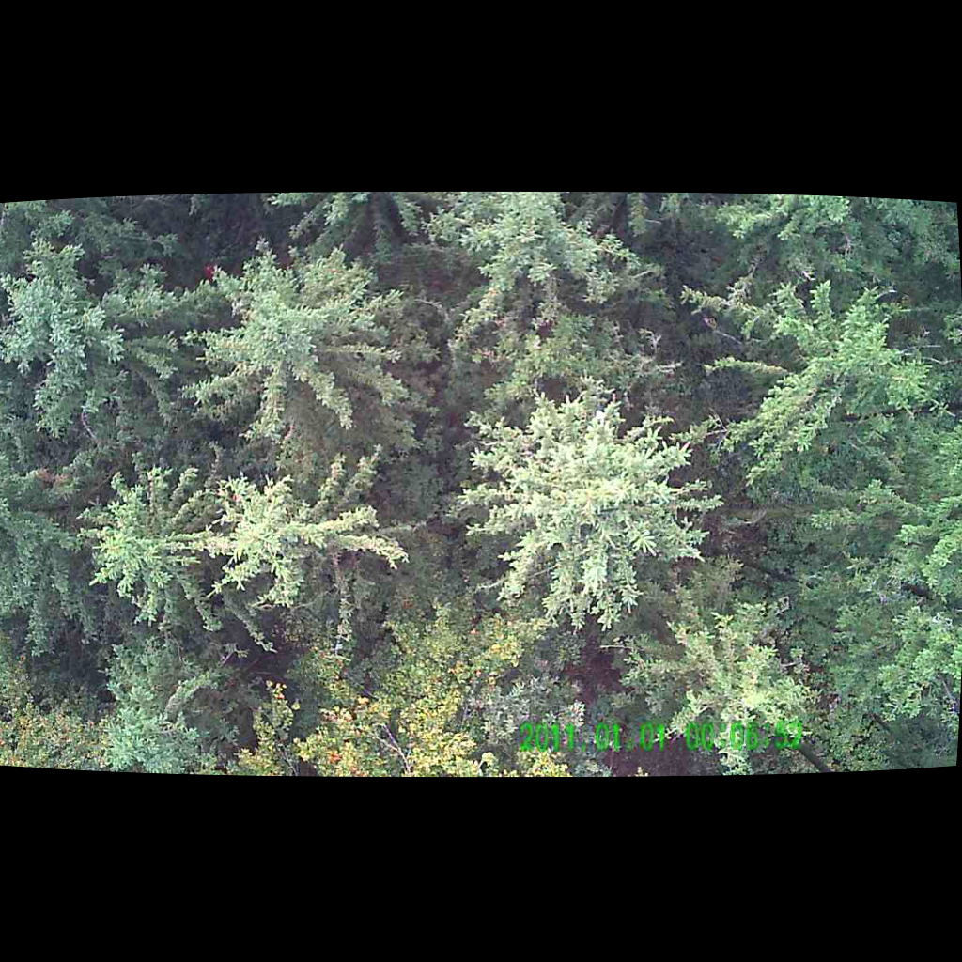
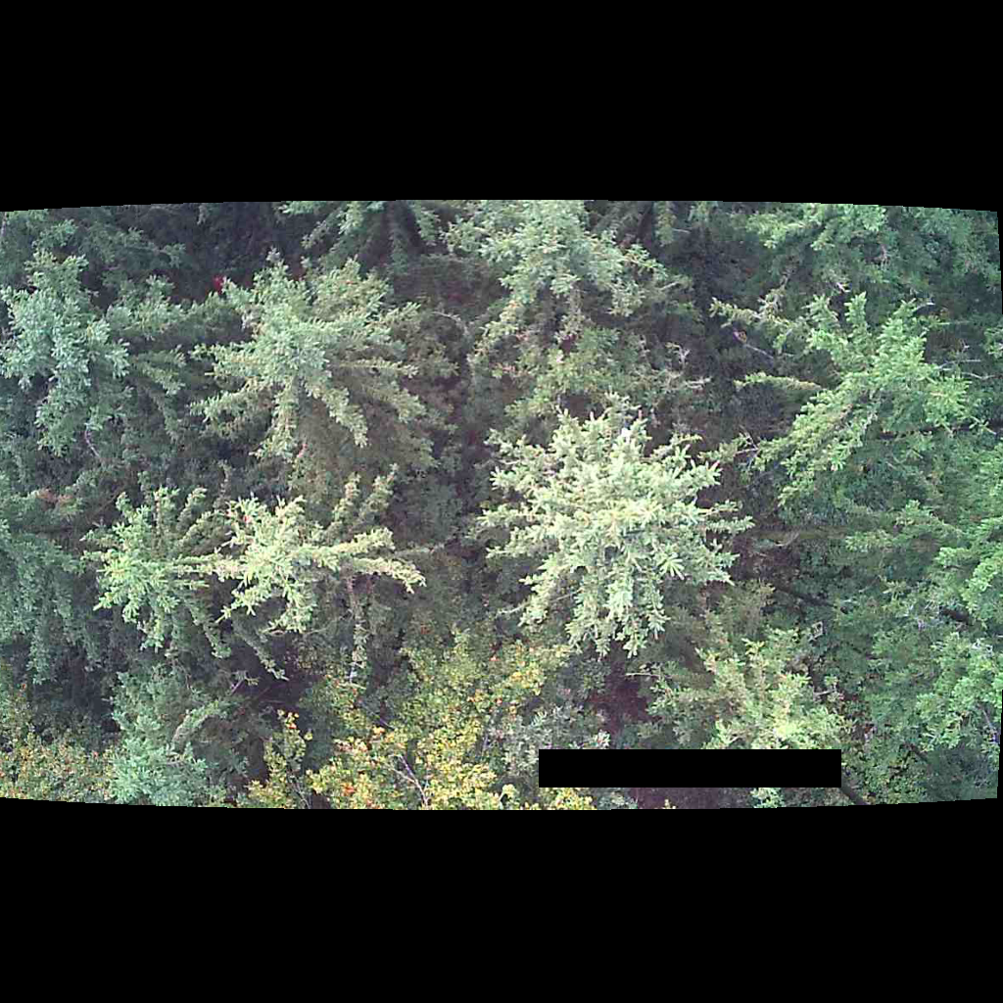

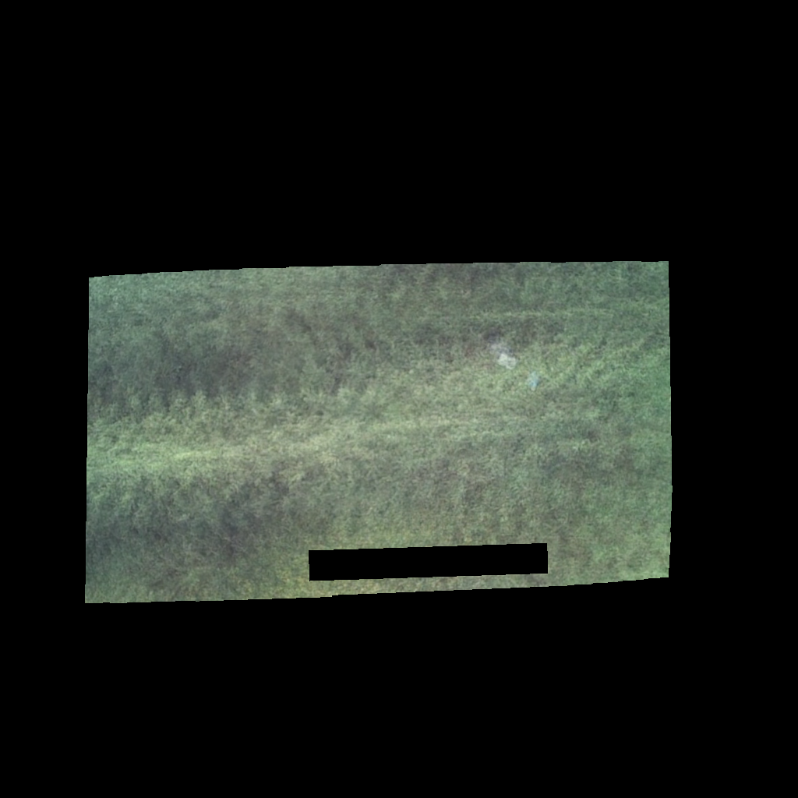
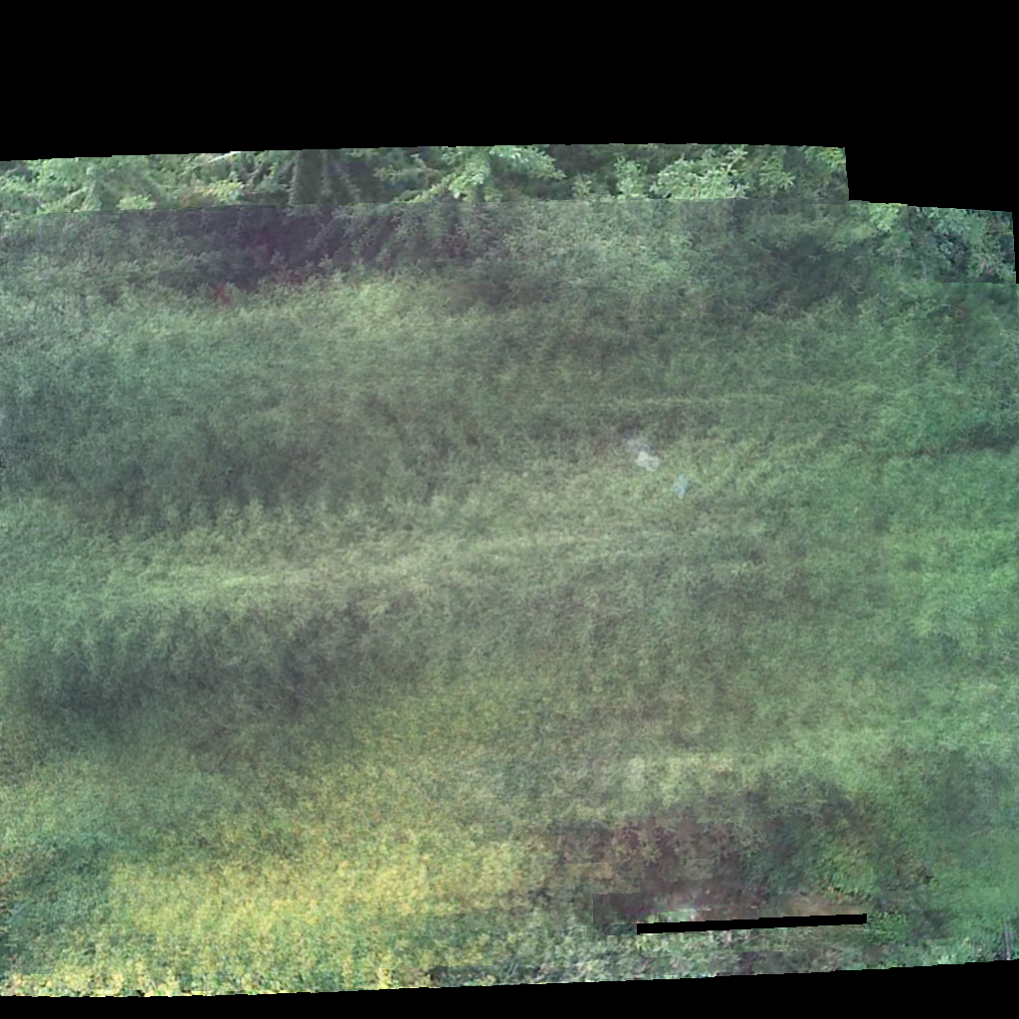
Image Pre-processing
1. apply mask for time stamp
2. warp to the same perspective
3. average over parallel recorded images
4. remove areas not covered by all 10 images
UE Computer Vision, 24th November, 2021

Slide 3
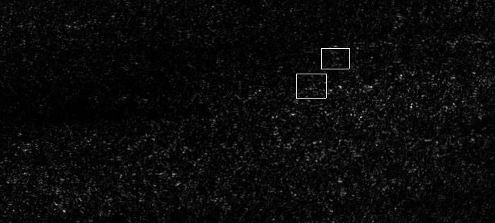
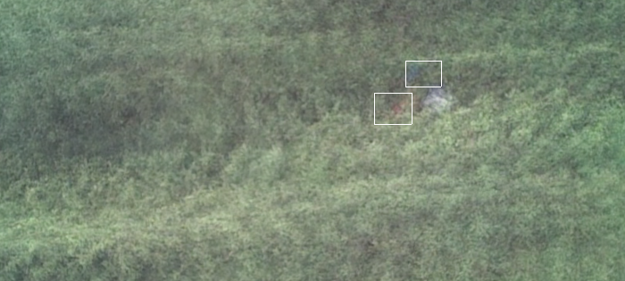
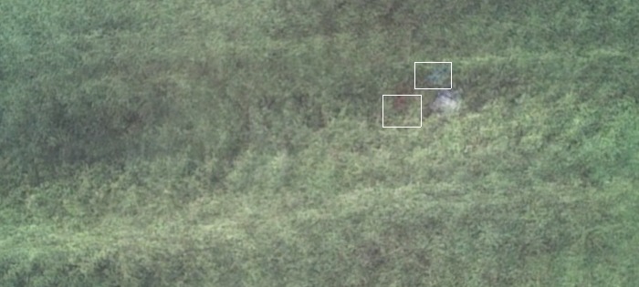
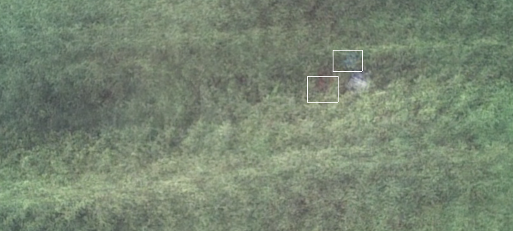
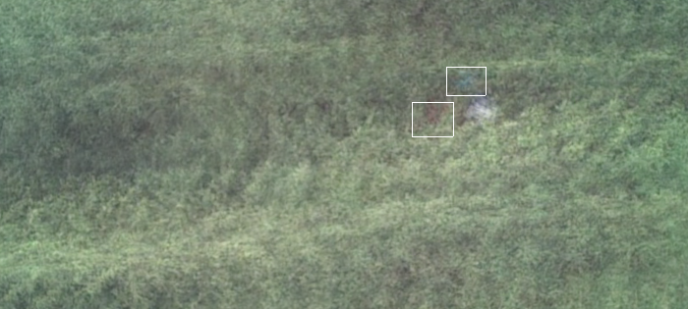
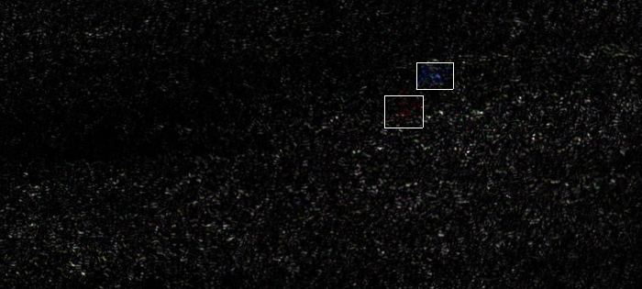
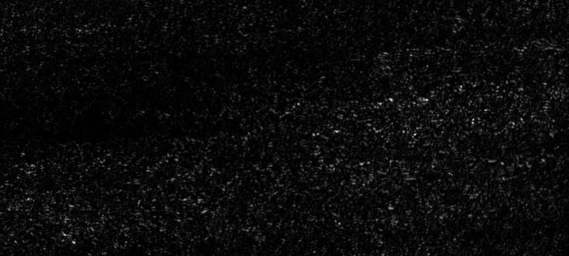


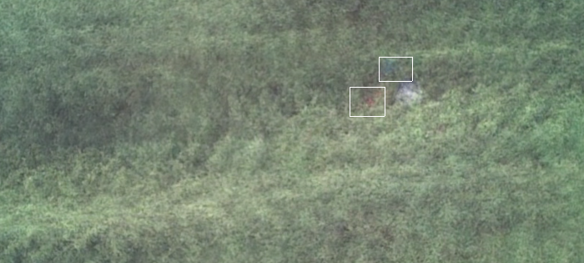
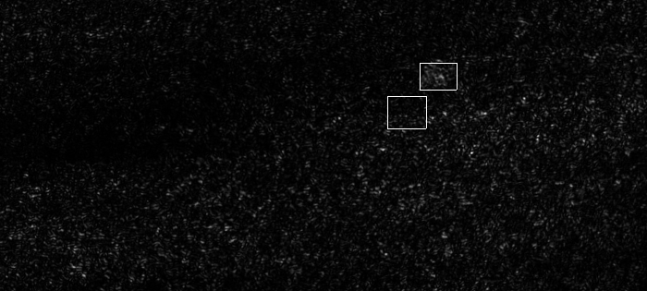
Image Pre-processing
7x700x315 px
R
Variance
G
B
UE Computer Vision, 24th November, 2021

Slide 4
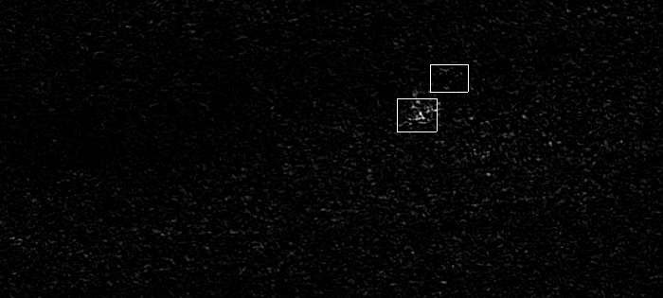
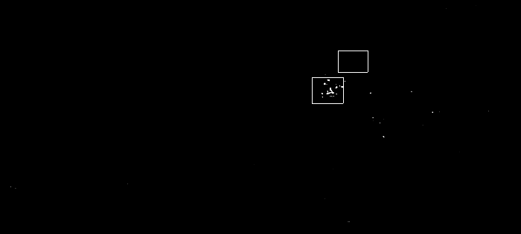
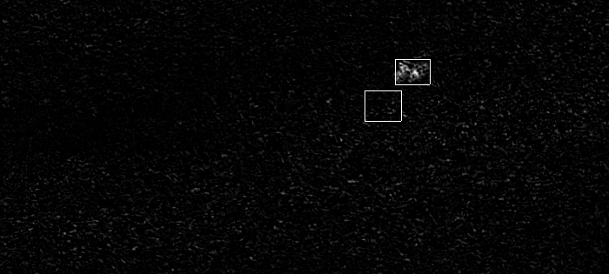
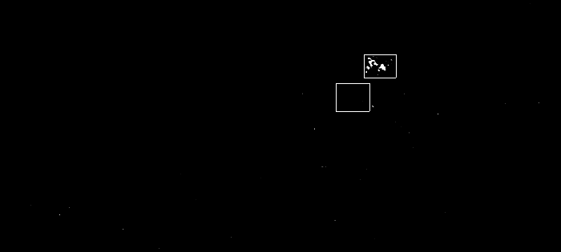
Image Pre-processing
Contrast ↑
Brightness↓
R - G
R
G
B
R - B
UE Computer Vision, 24th November, 2021

Slide 5
Image Pre-processing
Advantage:
can distinguish people from other objects by detecting movement
Disadvantage:
bias towards detecting people wearing blue or red – problems finding people with green clothing
cannot detect people that are not moving or moving too little
UE Computer Vision, 24th November, 2021

Slide 6
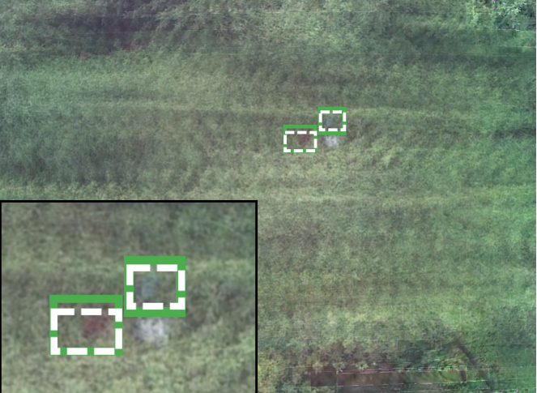
TODO
todo
UE Computer Vision, 24th November, 2021
UE Computer Vision, 24th November, 2021

Slide 7
TODO
Todo
UE Computer Vision, 24th November, 2021

Slide 8
THANK YOU FOR YOUR ATTENTION!

